Slide 1
TIMES OF CLOUD
Wednesday 1st February 2023

Slide 2
Extraction!!
The last 12 months have seen a number of significant innovations in cloud technology. Here are a few of the most notable:
Multi-Cloud and Hybrid Cloud Adoption
Serverless Computing
Containerization
Security
Artificial Intelligence and Machine Learning

Slide 3


Artificial Intelligence and Machine Learning

Slide 4
Artificial Intelligence (AI) and Machine Learning (ML) are rapidly advancing in the cloud and have become critical to organizations that want to extract valuable insights from their data. Cloud providers have been investing heavily in these technologies to make it easier for organizations to develop, deploy, and run AI and ML models.
CHATGPT!!!!!
One of the key benefits of using cloud-based AI and ML is that it enables organizations to process large amounts of data quickly and cost-effectively.
With the cloud, organizations no longer need to invest in expensive hardware and software to run their models. Additionally, cloud-based AI and ML services provide organizations with the tools they need to build, train, and deploy models, even if they don't have in-house expertise in these areas.
Another benefit of cloud-based AI and ML is that it enables organizations to collaborate more easily with partners and customers. By leveraging the cloud, organizations can share models and data in real-time, which can lead to new insights and opportunities.
Overall, the advancements in AI and ML in the cloud have made it easier and more cost-effective for organizations to derive value from their data. With the cloud, organizations can quickly and easily leverage the latest AI and ML technologies to gain new insights, make better decisions, and drive innovation.
Notes:
What is ChatGPT?
“We’ve trained a model called ChatGPT which interacts in a conversational way. The dialogue format makes it possible for ChatGPT to answer followup questions, admit its mistakes, challenge incorrect premises, and reject inappropriate requests.”

Slide 5
Economic impacts!
Consider the cost savings and cost benefits associated with cloud technology
How does cloud technology reduce capital expenditures, such as the need for hardware and software?
How does it reduce operational expenditures, such as the need for IT staff to manage hardware and software?
Cloud technology can significantly reduce capital expenditures by eliminating the need for physical hardware and reducing the need for software licenses.
It can also reduce operational expenditures by reducing the need for IT staff to manage hardware and software, as well as by providing more cost-effective solutions for disaster recovery and business continuity.

Slide 6
Performance impacts!
Consider the impact of cloud technology on application performance
Does cloud technology provide better scalability and availability compared to traditional IT solutions?
How does it improve the speed and responsiveness of applications?
Cloud technology can significantly improve application performance by providing better scalability and availability compared to traditional IT solutions.
It can also improve the speed and responsiveness of applications by providing access to high - performance computing resources.
Notes:
Several times, I asked ChatGPT the same question and received a different answer. This could be acceptable when working individually, but consistent coding standards are crucial when working at scale with multiple team members or departments.

Slide 7
Security impacts!
Consider the impact of cloud technology on security
How does it improve security compared to traditional IT solutions?
How does it protect data and ensure compliance with regulations?
Cloud technology can improve security compared to traditional IT solutions by providing stronger security controls and by offering a more secure infrastructure.
It can also help organizations to comply with regulations by providing secure and auditable storage of sensitive data.
Notes:
On the flip side, AI has the potential to help IT and security teams become more efficient and effective, enabling automated and/or semi-automated vulnerability detection and remediation as well as risk-based prioritization. That makes AI that can analyze data very promising for IT and security teams facing resource constraints, but unfortunately, this type of tool does not exist yet and when it does it may be complicated to implement because of the training required for it to understand “normal” in a particular environment.

Slide 8
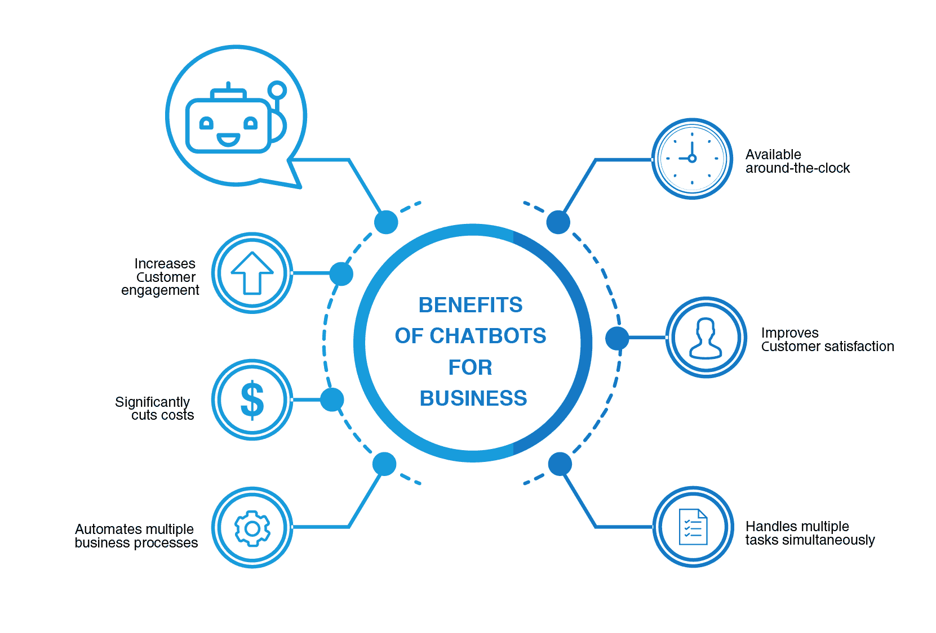
Benefits on the provision of services or applications
Consider the impact of cloud technology on the delivery of services and applications
How does it improve the speed
and efficiency of service delivery?
How does it improve the user
experience?
Notes:
Cloud technology can improve the speed and efficiency of service delivery by providing a more flexible and scalable infrastructure.
It can also improve the user experience by providing faster and more responsive applications

Slide 9
Novelty when compared to solutions from other competitors
How does it differ from other cloud solutions offered by competitors?
How does it provide unique benefits or capabilities compared to other solutions?
In best answer is in Healthcare industry!
Notes:
https://www.wordstream.com/blog/ws/chatbots

Slide 10
Thank You

